Slide 1



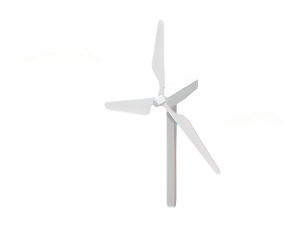
Weekly report: Storage System
Week number: 02
Date: 07/010/2025
Supervisor: Dr. Laurence Alhrshy
Group members: Mohamed Ahmed

Slide 2

Battery Technologies for Large-Scale Energy Storage
Content
Introduction
Lithium-Ion Batteries
Sodium-Sulfur Batteries
Flow Batteries
Comparative Summary Table
Technology Selection for Our Project
Conclusion

Slide 3
Introduction
Energy storage lies at the core of the renewable energy revolution. As the world shifts toward clean and sustainable power, batteries have become essential for balancing supply and demand.
In this presentation, we will explore the main battery technologies used for large-scale energy storage, highlighting their advantages, disadvantages, costs, and leading manufacturers. Finally, based on our analysis, we will identify the most suitable battery type for our project.

Slide 4
Lithium-Ion Batteries Lithium-Ion Batteries: Pros & Cons
Cons | Pros
High Cost: More expensive upfront compared to other battery types | High Energy Density: Stores a large amount of energy in a compact, lightweight form (150–200 Wh/kg).
Limited Lifespan: Capacity gradually decreases (~20% loss after 500 cycles) | Long Cycle Life: Can last several years with over 1,000 charge–discharge cycles.
Safety Risks: Risk of thermal runaway, requiring careful handling. | Fast Charging: Allows quick recharge with new fast-charging technologies.
Environmental Impact: Mining and disposal affect sustainability. | Low Self-Discharge: Retains charge well (only 2–3% loss per month).
Temperature Sensitivity: Performance drops in extreme temperature. | Variety of Sizes and Shapes: Flexible design for multiple applications.

Slide 5
Sodium-Sulfur Batteries
Sodium-Sulfur Batteries: Pros & Cons
Disadvantages | Advantages
Operates at high temperatures (300–350°C) | High energy density (~150 Wh/kg)
Safety risks due to molten sodium and sulfur | Long cycle life (1000–2000 cycles)
Large size and heavy weight | High charge/discharge efficiency (89–92%)
Shuttle effect can reduce capacity and performance | Relatively low cost per unit energy
Poor performance at room temperature | Compatible with renewable energy storage

Slide 6
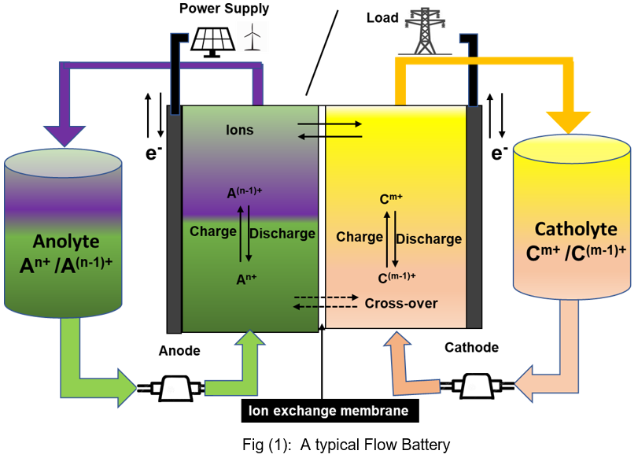
Flow Batteries
Flow Battery Technologies: RFBs have been investigated and produced during the past few decades using various chemistries. Among them the commercialized deployment of all vanadium RFB began in the 1980s.
Main types of Flow Batteries
All-Vanadium Redox Flow Battery (VRFB)
Zinc–Bromine Flow Battery (ZBFB)
Iron–Chromium Flow Battery (Fe–CrFB)
Aqueous Organic Redox Flow Battery (AORFB)
Metal–Air Flow Battery (MAFB)
Semi-Solid Flow Battery (SSFB)
Solar Redox Flow Battery (SRFB)
Solid-Mediated Flow Battery (SMFB)

Slide 7
Flow Batteries
Flow Batteries: Pros & Cons
Disadvantages | Advantages
Low energy/power density | Very low stand-by loss (almost no self-discharge)
High capital cost, especially membranes ($200–600/m²; new membranes ~$50/m²) | Stable performance regardless of power demand
Requires technological improvements for industrial applications | Long cycle life (≥2000 cycles on average; some >10,000)
Need for optimized cell design to reduce ohmic and activation losses | Electrodes remain chemically and physically stable
Complex system structure (separate tanks, flow fields) | High safety and recyclability

Slide 8
Costs & Leading Manufacturers
Leading Manufacturers | Costs | Types
China-based CATL and BYD, South Korean companies ,like LG and Samsung SDI, and Japan-based Panasonic. Other notable players are the US-based Tesla Gigafactories and several prominent companies in China, such as Tianneng Group and Microvast. | about $151 per kWh | Lithium-Ion Batteries
Infinite Energy Systems (UK) Sumitomo Electric Industries, Ltd. (Japan) VRB Energy (Canada) Enerox GmbH (Austria) Elestor (The Netherlands) ESS Tech, Inc. (US) Largo Inc. (Canada) Lockheed Martin Corporation (US) Primus Power (US) | $260–$500 per kWh (The price varies depending on the type) | Flow Batteries
NGK Insulators Ltd.,EaglePicher Technologies LLC,GE Energy Storage,BYD Company Limited,Furukawa Battery Co., Ltd.,Amara Raja Batteries Ltd.,Samsung SDI Co., Ltd. EnerVault Corporation,Ceramatec, Inc.,Sieyuan Electric Co., Ltd. | $300–$450 per kWh | Sodium-Sulfur Batteries

Slide 9
Technology Selection for Our Project
Project Conditions:
The wind turbine is IEC Class 3A with a 160 m rotor diameter, indicating high capacity and variable generation.
The system requires medium to long-term energy storage (several hours) to balance wind fluctuations.
Project space is not highly constrained, allowing installation of a large-scale Flow Battery system.
Safety and long lifespan are prioritized over high energy density.
Final Selection: Vanadium Redox Flow Battery is Most suitable for large-scale wind applications, providing long-duration storage, stable performance, and extended operational lifetime.
Hybrid Energy Storage System (HESS): Flow Battery: For long-duration energy storage (hours). Li-ion Battery: For fast response and frequency regulation.

Slide 10
Technology Selection for Our Project
Enerox / CellCube (Austria / The CellCube family) Why?
European manufacturing — high quality and reliable production standards.
Geographical proximity (Europe → Middle East) — easier logistics and shorter delivery times.
Proven operational track record — numerous successful systems deployed across Europe.
Strong commercial experience — established projects and long-term clients
Easy communication and support — accessible and responsive European supplier

Slide 11
References
https://www.battery.associates/post/state-of-art-of-flow-batteries-a-brief-overview
https://bslbatt.com/blogs/lithium-battery-price-2025-current-costs-trends-and-changes/
https://www.sciencedirect.com/science/article/pii/S0306261924003374
https://www.skyquestt.com/report/sodium-sulfur-battery-market/companies
https://www.sciencedirect.com/topics/engineering/sodium-sulfur-battery#:~:text=Sodium%E2%80%93sulfur%20batteries%20offer%20long%20battery%20lifetime%20(up,its%20explosiveness%20have%20constrained%20its%20wide%2Dscale%20implementation.

